Slide 1
Emergent phenomena at oxide interfaces
Chen Ke, Liu Donghao, Lv Peng, Shen Bingran,
Yan Qirui, Yang Wuhao, Ye Qijun, Zhu Chenji
Nov. 19th

Slide 2
Outline
Basics
  Transition metal oxides and its interface
  Interacting electrons and magnetism
  Charge, orbital and spin reconstructions
Application
  Interface superconductivity
  Fractional quantum Hall effect

Slide 3
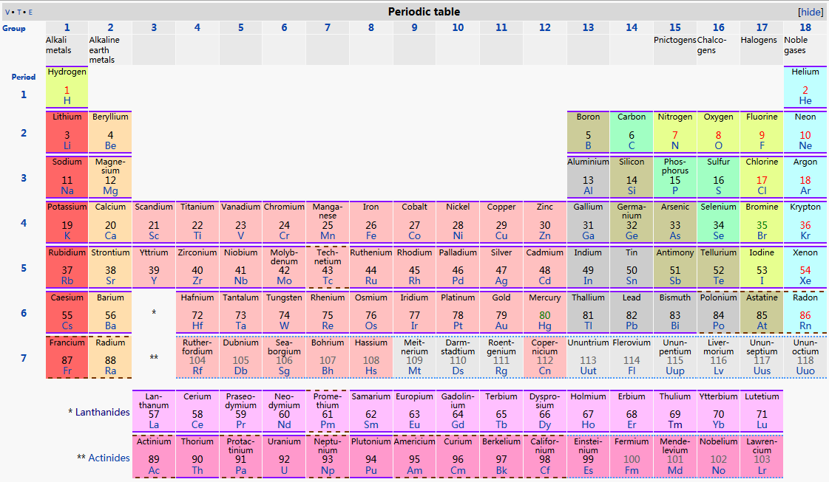
The periodic table

Slide 4
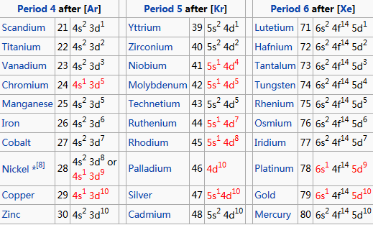
Electronic structure of TM
The d electrons play the domain role in TMOs properties

Slide 5
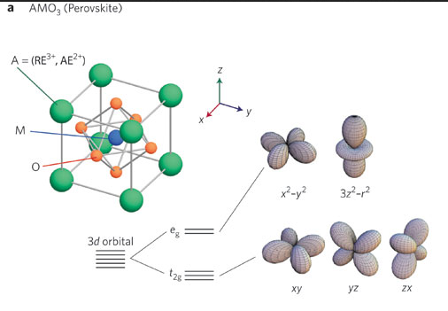
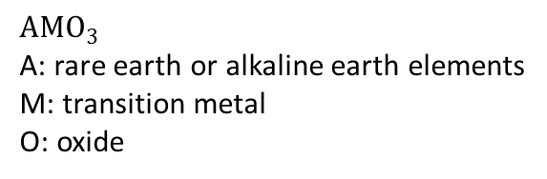
Perovskite structure of TMOs
$$AMO_{3}$$
A: rare earth or alkaline earth elements
M: transition metal
O: oxide

Slide 6
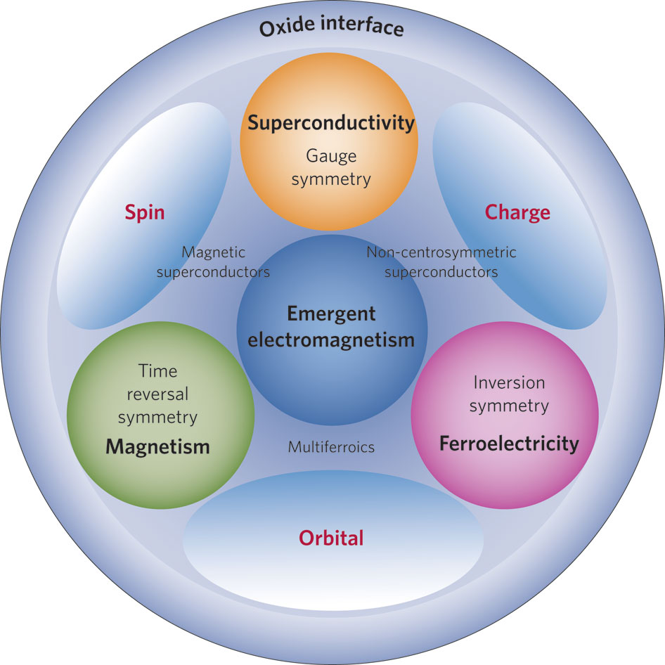
A fundamental understanding
the symmetry of the order parameter
Symmetry change leads to phase transition
  Spatial inversion (I)
  Time-reversal (T)
  Gauge (G)
  Spontaneous electric polarization
  Magnetism
  Superconductivity or super fluidity
Break
Notes:
the ordered phase has lower symmetry than the Hamiltonian of the system

Slide 7
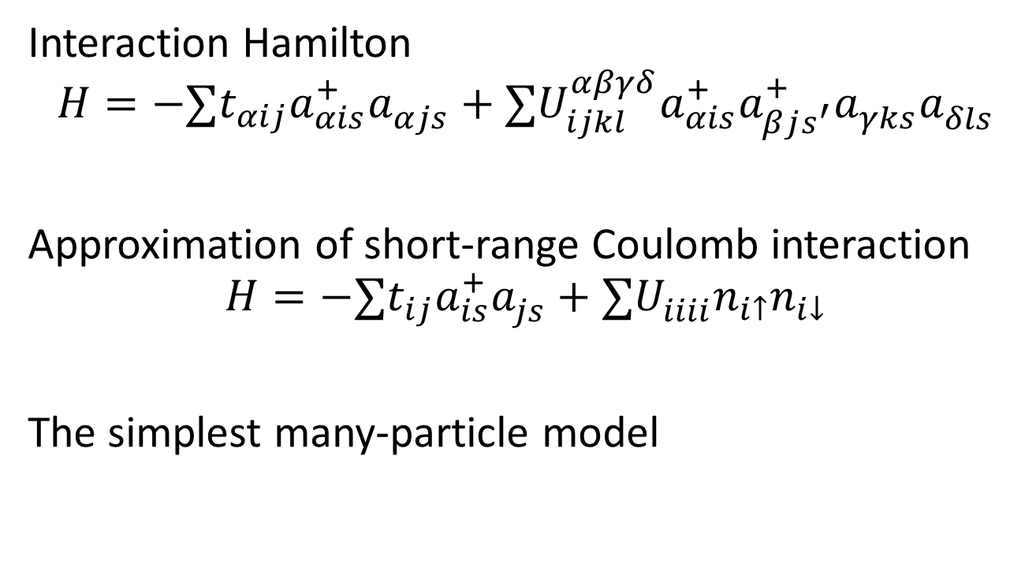
Hubbard model
Interaction Hamilton
$$H=−∑t_{αij}a_{αis}^{+}a_{αjs}^{ }+∑U_{ijkl}^{αβγδ}a_{αis}^{+}a_{βjs^{′}}^{+}a_{γks}^{ }a_{δls}^{ }$$
Approximation of short-range Coulomb interaction
$$H=−∑t_{ij}a_{is}^{+}a_{js}^{ }+∑U_{iiii}^{ }n_{i↑}n_{i↓}$$
The simplest many-particle model

Slide 8
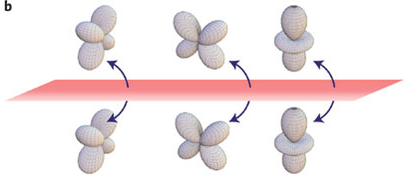
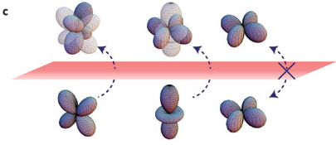
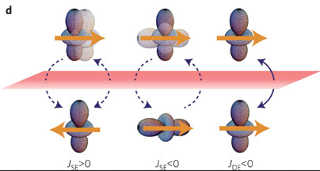
Hopping process
e_g
t_2g

Slide 9
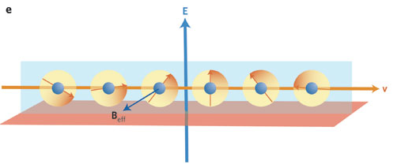
Relativistic effects

Slide 10
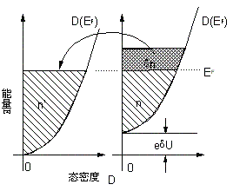
Charge transfer
CaMnO_3
CaRuO_3
heterointerface
Antiferromagnetic
insulator
Paramagnetic
metal
ferromagnetic

Slide 11
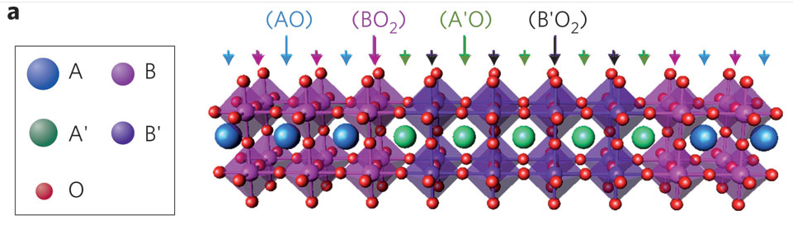
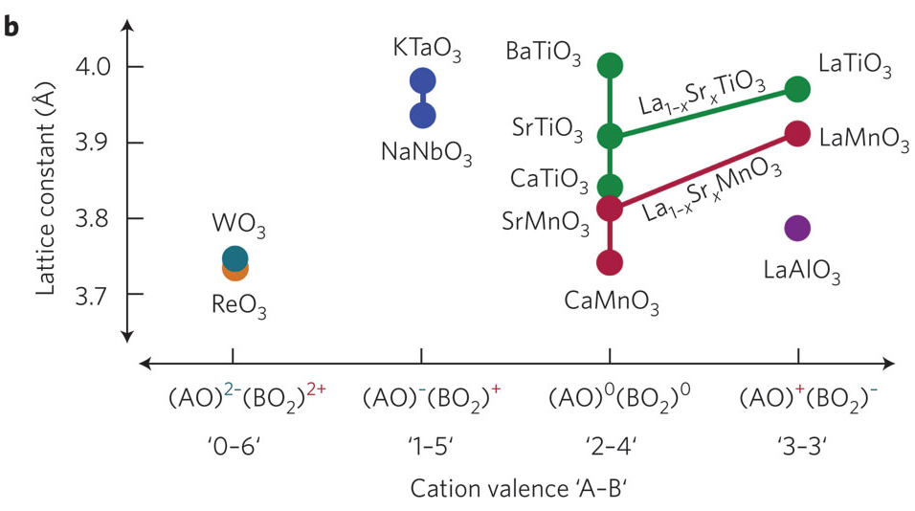
Electrostatic boundary conditions
Polar catastrophe

Slide 12
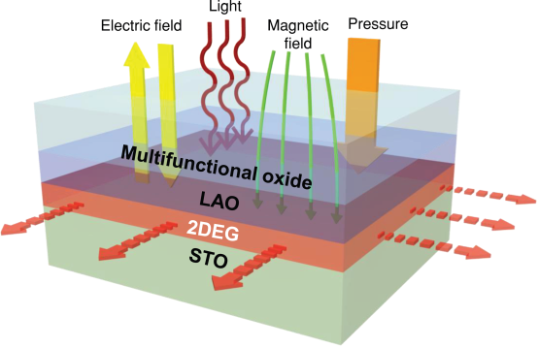
Interface superconductivity
LaAlO₃/SrTiO₃ heterostructure

Slide 13
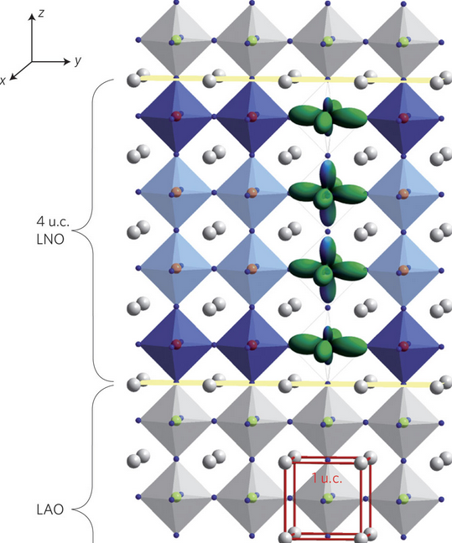
Spin & orbital reconstructions
With charge transfer
With the mismatch of lattice parameter
With the local structure differing from bulk

Slide 14
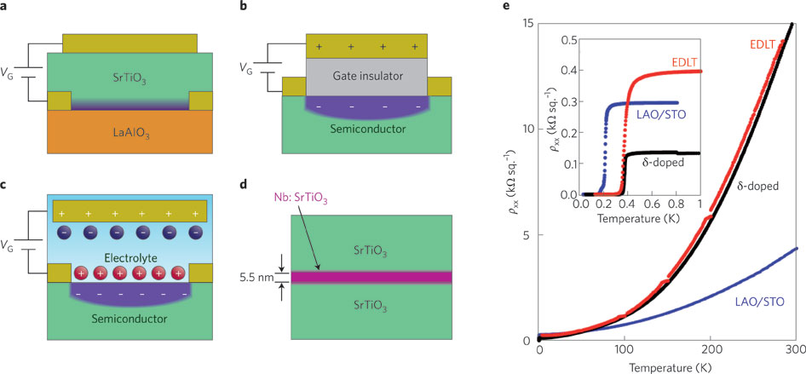
Various device structure
Phys. Rev. Lett. 103, 226802 (2009).
Nature Mater. 7, 855–858 (2008).
Nature 462, 487–490 (2009).

Slide 15
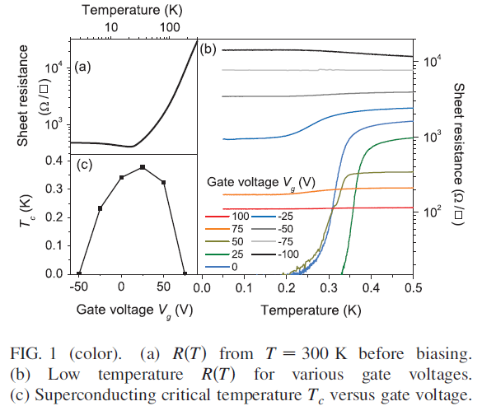
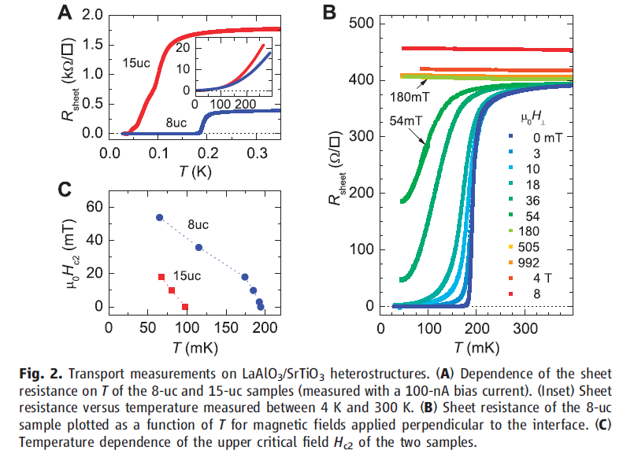
Response to external field
Phys. Rev. Lett. 103, 226802 (2009).
Nature Mater. 7, 855–858 (2008).

Slide 16
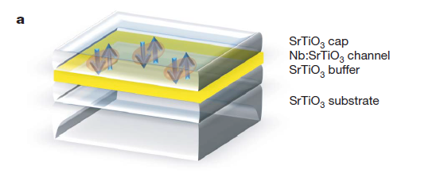
δ-doping SrTiO₃
Nature 462, 487–490 (2009).
Dopant-layer thickness below the other character length
Free from large electronic disorder, high quality
High mobility
Shubnikov–deHaas oscillations in normal state

Slide 17
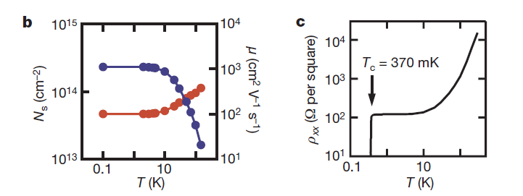
Sample structure and transport characterization
b, Low-field sheet carrier density, Ns (red), and electron Hall mobility, m (blue), versus temperature.
c, Sheet resistance, rxx, versus temperature, showing a clear superconducting transition at 370 mK.

Slide 18
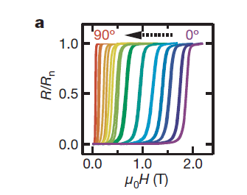
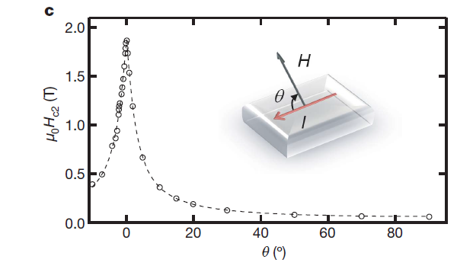
Two-dimensional superconducting characteristics
a, Measurement of superconducting upper critical field, Hc2, using resistance versus magnetic field, H, for various angles between the sample plane and the magnetic field at T=50 mK. Rn, normal-state resistance.

Slide 19
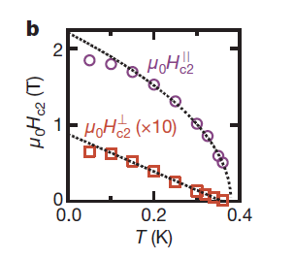



Two-dimensional superconducting characteristics

Slide 20
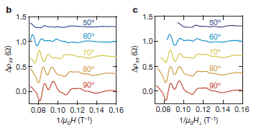
Shubnikov-de Haas oscillations
The SdH oscillations are oscillations of the resistivity parallel to the current flow in the edge states of a 2DEG in an applied magnetic field.
related to the Quantum-Hall effect and share the same 1/B-periodicity.
Effective tool to investigate electronic structure

Slide 21
Fractional quantum Hall effect in ZnO/(MgZn)O heterostructures

Slide 22
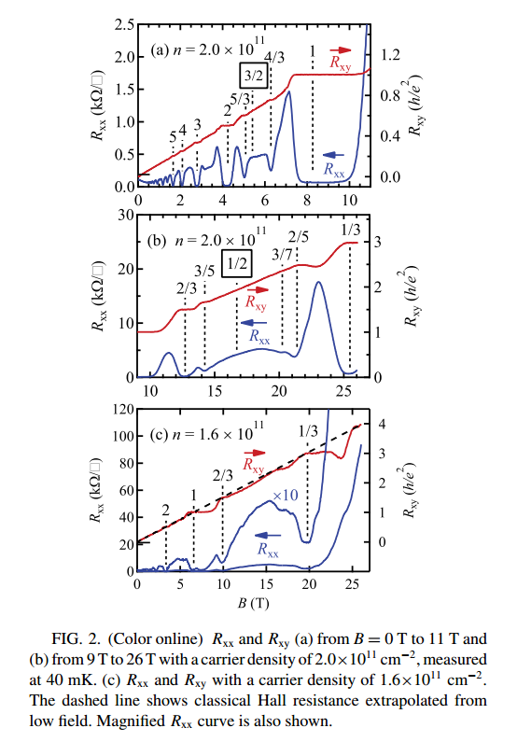
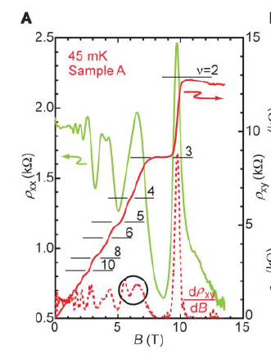
Experiments
Science 315, 1388–1391 (2007).
Phys. Rev. B 84, 033304 (2011).

Slide 23
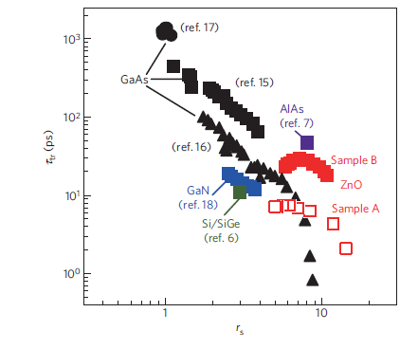
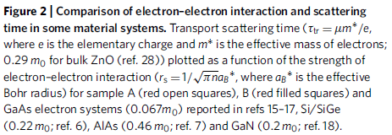
Nature Mater. 9, 889–893 (2010).

Slide 24
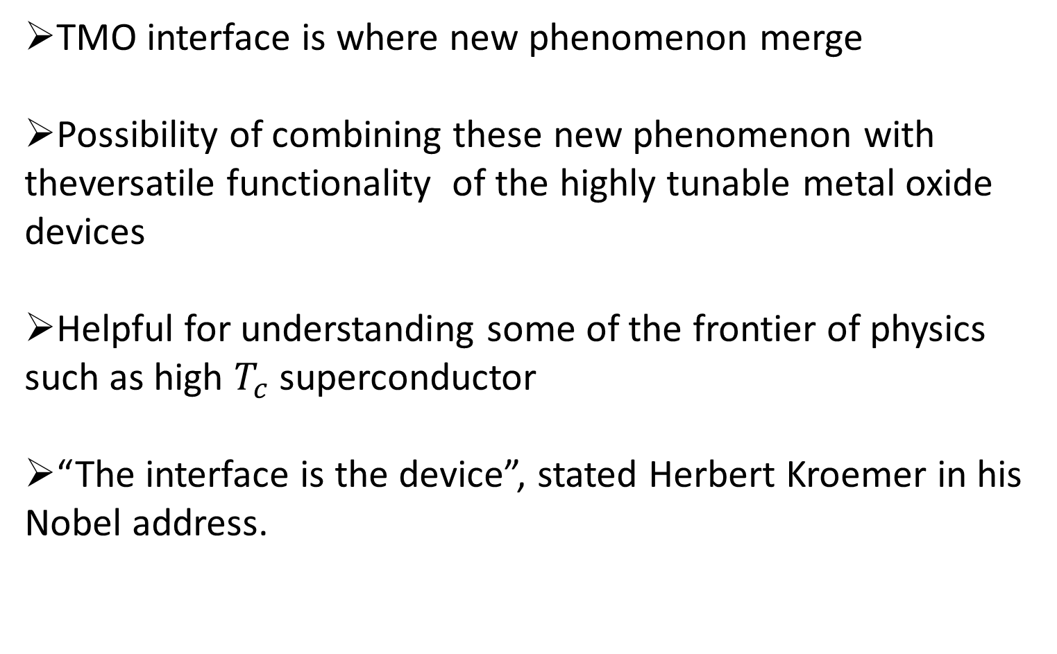
Summary
TMO interface is where new phenomenon merge
Possibility of combining these new phenomenon with theversatile functionality of the highly tunable metal oxide devices
Helpful for understanding some of the frontier of physics such as high $T_{c}$superconductor
“The interface is the device”, stated Herbert Kroemer in his Nobel address.

